Slide 1
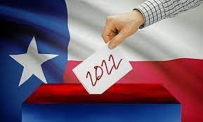
Duties of the County Chair
Christina Worrell Adkins
Legal Director,
Elections Division
Kristi Hart
Manager,
Election Administration and Voter Registration

Slide 2
Agenda
Resources
Important Dates
Duties of the County Chair
Candidacy
Ballot Certification/Preparation
Election Night Reporting (ENR)
Canvassing Procedures

Slide 3
Resources

Slide 4
Available Resources
Secretary of State
  Primary Calendar & Appendices
  2022 Candidate’s Guide
  Training Materials
    Election Judges and Clerk’s Handbook
    Early Voting Ballot Board Handbook
    Poll Watcher Handbook
    Online Election Worker Training
    Online Poll Watcher Training (Coming soon!)
  Advisories - Conducting Your Elections
  Assistance by Phone and Email
  County Chair Handbook
County Election Official
  Early Voting
  Contracts/Joint Elections
  Voting Systems
  Institutional knowledge
  Web Postings!!
State Chairs
  Party Rules
Texas Ethics Commission
  Campaign Finance

Slide 5
Websites
http://www.sos.texas.gov/elections/
http://www.votetexas.gov/

Slide 6
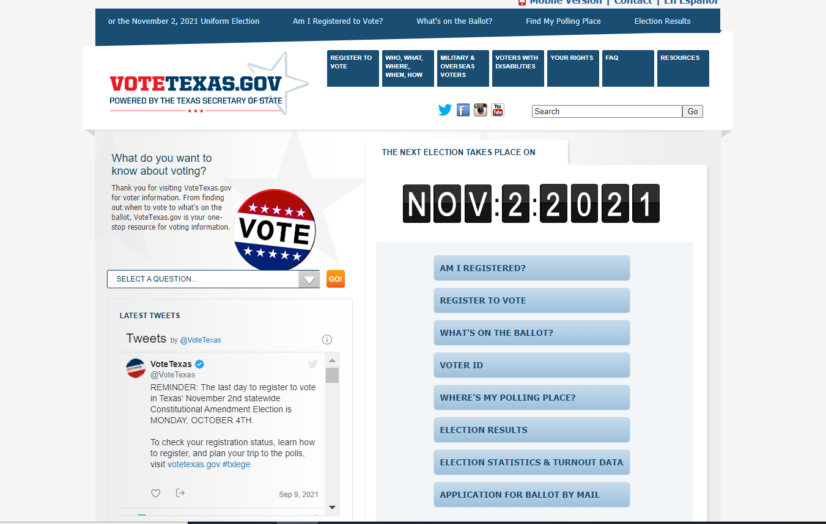
www.votetexas.gov
Available in Spanish and English
Mobile Site
Updated for each Uniform Election
Please feel free to link to this website to assist in providing information to voters

Slide 7
Duties of the County Chair

Slide 8
Duties of the
County Executive Committee
Supervises conduct of primary (172.111)
Approval of primary contracts/ Joint Primary Agreements (31.092)
Approval of Judges in primary election/s (32.006)
Determine Consolidation of Precincts in primary election (42.009)
Appoint poll watchers in elections with partisan candidates
Nominate to fill vacancies under certain circumstances. (202.006)
Adoption of Voting System in primary election (123.001)
Conducts Ballot Drawing for primary election, if requested to by primary committee (172.082)
Sets time and place for precinct conventions (174.022)

Slide 9
Duties of the
County Chair - Generally
Serves on County Election Commission (31.032)
Serves on County Election Board (51.002)
Provides list of judges for appointment by commissioners court (32.002)
Provides list of potential election day clerks for general election for state and county officers (32.034)
Provides list of Early Voting workers
Appoints judges for primary election (32.006)
Appoints poll watchers for elections with party nominee on ballot (Not primary) (33.003)

Slide 10
Duties of the
County Chair - Primary Election
Filing authority for candidate applications (172.021)
Serves as Chair of Primary Committee, if established (172.081)
Submit names of candidates in SOS Candidate Filing System (172.029)
Conducts Ballot Drawing (172.082)
Prepares ballots in primary election (52.002)
Designates polling locations in primary (43.003)
Procures and allocate supplies in primary, with approval of Co Exec. Committee (51.003)
Provides list of names for early voting workers in a primary election (85.009)
Appoints Signature Verification Committee in Primary (87.027)
Certifies names for general election ballot (172.117)

Slide 11
County Chair in Polling Place
County Chair may be in a primary polling place during the voting period as necessary to perform administrative functions related to the conduct of the election.
Sec. 172.1113

Slide 12
Distribution of Convention Notices
Political party may prepare a notice for distribution notifying voter of party’s convention process.
  State chair shall prescribe form, form must be approved by SOS.
  County chair may prescribe a more specific form, if approved by SOS

Slide 13
Appointing Election Workers
Appointing Authority
Number Appointed
Qualifications
Duties

Slide 14
Who Appoints for Primary Election?
Position | Appointer
Election Judge (Presiding and Alternate) | County Chair, with approval of County Executive Committee (32.006)
Election Clerks | Presiding Judge (32.003)
Early Voting Clerk | N/A - EVC is County Clerk/Elections Administrator (83.002)
Deputy Early Voting Clerks | County Clerk/Elections Administrator (83.032)
Early Voting Ballot Board Judge | County Chair, with approval of County Executive Committee (32.006 and 87.002(a))
Early Voting Ballot Board Member | Presiding Judge of Early Voting Ballot Board (87.002(a))
Signature Verification Committee Member | County Chair (87.027(b))
Central Counting Station Manager | Authority Establishing Central Count (127.002)
Tabulation Supervisor | Authority Establishing Central Count (127.003)
Assistants to the Tabulation Supervisor | Tabulation Supervisor, with approval of Authority Establishing Central Count (127.004)
Presiding Judge of Central Count | County Chair, with approval of County Executive Committee (32.006 and 127.005(a))
Clerk of Central Counting Station | Central Counting Station Manager or Presiding Judge of Central Count (127.006)

Slide 15
Who Appoints for Joint Primary?
Position | Appointer
Election Judge (Presiding and Alternate) | County Clerk via “List Procedure” (172.126) Must have at least one co-judge from each party.
Election Clerks | County Clerk via “List Procedure” (172.126) Must have at least one clerk from each party.
Early Voting Clerk | N/A - EVC is County Clerk/Elections Administrator (83.002)
Deputy Early Voting Clerks | County Clerk/Elections Administrator (83.032)
Early Voting Ballot Board Judge | County Clerk via “List Procedure” (172.126)
Early Voting Ballot Board Member | County Clerk via “List Procedure” (172.126)
Central Counting Station Manager | County Clerk via “List Procedure” (172.126)
Tabulation Supervisor | County Clerk via “List Procedure” (172.126)
Assistants to the Tabulation Supervisor | County Clerk via “List Procedure” (172.126)
Presiding Judge of Central Count | County Clerk via “List Procedure” (172.126)
Clerk of Central Counting Station | County Clerk via “List Procedure” (172.126)

Slide 16
Number of Personnel
Location | Number | Roles
Precinct Polling Location | -Minimum of 3 per precinct -Maximum # of clerks set by appointing authority (county chair) | -Presiding Judge -Alternate Judge/Clerk -Election Clerks
Early Voting Personnel | -Recommend 2 per early voting location. -No maximum - appoint # of deputies necessary to conduct early voting. | -Early Voting Clerk -Deputy Early Voting Clerk
Early Voting Ballot Board | -Minimum of 3 – presiding judge and two other members. -No maximum – appoint # necessary for Board tasks. | -Presiding Judge -Early Voting Ballot Board Members
Signature Verification Committee (If any) | -Minimum of 5 members. -No maximum – appoint # necessary to conduct committee tasks. | -Signature Verification Committee Members
Central Counting & Central Accumulation Station | -Minimum of 3: CCS manager, tabulation supervisor & presiding judge. -Minimum of 4 for elections in which alternate presiding judge appointed. -No maximum – may appoint # of clerks and assistants to tabulation supervisor as necessary | -Central Counting Station Manager -Tabulation Supervisor -Assistants to Tabulation Supervision -Presiding Judge -Clerks

Slide 17
Number of Workers Per Precinct
Number of Election Workers Per Voting Precinct (1 T.A.C. 81.117) (Includes one judge and one alternate judge who serves as a clerk)
Estimated Turnout Per Polling Location | Paper Ballot/Optical Scan (primary voting method) | Electronic Voting System (primary voting method)
200 or fewer | 3 | 3
201 - 400 | 5 | 4
401 - 700 | 6 | 5
701 - 1,100 | 8 | 6
1,101 or more | 12 | 8

Slide 18
Number of Workers – Joint Primary
Number of Election Workers Per Joint-Voting Precinct (1 T.A.C. 81.149) (Includes two co-judges and two alternate judges who serve as a clerk)
Estimated Turnout Per Joint-Polling Location | Paper Ballot/Optical Scan (primary voting method) | Electronic Voting System (primary voting method)
200 or fewer | 4 | 4
201 - 400 | 6 | 5
401 - 700 | 7 | 6
701 - 1,100 | 9 | 7
1,101 or more | 13 | 9

Slide 19
Qualifications – Poll Workers
 | Election Judge | Election Clerk
Qualified Voter of _________ | Precinct (If unable to find qualified voter of precinct, may use qualified voter of political subdivision → clerk requirements) | Political Subdivision (County, City, etc.)
Can be an employee of political subdivision? | Yes – if there is no other legal or practical conflict, e.g. employee of candidate. | Yes – if there is no other legal or practical conflict, e.g. employee of candidate.
Can be a candidate? | No – if candidate for a contested office in election held on that day → cannot serve in a precinct for which candidate appears on ballot. | No – if candidate for a contested office in election held on that day → cannot serve in a precinct for which candidate appears on ballot.
Can be a relative of candidate? | No – if related within the second degree of consanguinity or affinity to an opposed candidate → cannot serve in a precinct for which candidate appears on ballot. | No – if related within the second degree of consanguinity or affinity to an opposed candidate → cannot serve in a precinct for which candidate appears on ballot.
Can be an employee of candidate? | No – if candidate is opposed and employer of judge → cannot serve in a precinct for which candidate appears on ballot. | No – if candidate is opposed and employer of clerk → cannot serve in a precinct for which candidate appears on ballot.
Can be employee of campaign? | No – if campaign manager or treasurer. Unadvisable – If serving other role within campaign. | No – if campaign manager or treasurer. Unadvisable – If serving other role within campaign.
Can be an public officeholder? | No – if they hold elective public office. | No – if they hold elective public office.
Can be convicted of election offense? | No – if finally convicted of election related offense. | No – if finally convicted of election related offense.

Slide 20
Qualifications – Early Voting Ballot Board and Signature Verification Committee
 | Early Voting Ballot Board Judge and Member | Signature Verification Committee Member
Qualified Voter of _________ | Territory served by early voting clerk. | The county in a primary election.
Must meet all other requirements of an election judge? | Yes. | No requirement.

Slide 21
Qualifications – Central Counting Station (CCS)
 | CCS Manager | Tabulation Supervisor | Assistant Tabulators | CCS Judge | CCS Clerks
Registered Voter of _________ | Political subdivision of authority establishing CCS | Political subdivision of authority establishing CCS | No requirement. | Political subdivision of authority adopting voting system | Political subdivision.
Registered voter unless… | Person is employee or it’s the first year of adoption | Person is employee | County over >60K, N/A County <60K, yes or employee | N/A | N/A
Can be an employee of political subdivision? | Yes. | Yes. | Yes. | Yes. | Yes – if no other legal or practical conflict.
Can be a candidate or officeholder? | Yes – if general custodian of election records. | No. | Yes – if no other legal or practical conflict. | Yes – if general custodian of election records. | No.
Other requirements | Knowledge of voting system | Trained on voting system. | Trained on voting systems | None. | None.
Must meet other requirements of an election judge? | Yes. | Yes. | No. | Yes. | Must meet clerk requirements.

Slide 22
Duties
Position | Duties
Election Judge | Management of polling place on election day; preserve order and prevent breaches of peace. Management of clerks’ hours and activities.
Election Clerks | Performs duties assigned by judge in conducting election.
Early Voting Clerk | Officer in charge of conducting early voting for the election. Also, maintains hours on election day for early voting activities. Provide notice of clerks address per 83.010.
Deputy Early Voting Clerk | Also, an officer of the election for conducting early voting with same authority of EVC subject to their supervision.
Early Voting Ballot Board Judge and Members | EVBB process early voting results for the election and processes provisional ballots.
Signature Verification Committee Member | SVC compares signatures on application for mail ballot to carrier envelope to confirm signature is that of the voter’s.
Central Counting Station Manager | Management of central counting station and personnel; established written plan for station.
Tabulation Supervisor | Management of automatic tabulating equipment for counting ballots.
Assistants to the Tabulation Supervisor | Assists with automatic tabulating equipment.
Judge of Central Count | Maintaining order of station, and conferring with personnel and review of irregularly marked ballots.
Clerk of Central Counting Station | Assists manager or judge with functions of station.

Slide 23
Candidacy

Slide 24
Filing Period
Filing Period
  Public Offices:
    November 13, 2021 – December 13, 2021 (6:00 PM)
  Precinct Chair:
    First Filing Period: September 14, 2021 – December 1, 2021 (11:59 PM)
    Second Filing Period: Set by SOS in accordance with SB 13

Slide 25
Required Notice
NOTICE OF ADDRESS FOR FILING APPLICATIONS
  Posted by county chair (or secretary of the county executive committee)
  Contains address at which county chair and/or secretary of the CEC will be available to receive applications on the last day for filing an application.
  Must be posted not later than the day before the last day to file.
  Must be posted on the political party’s Internet website or in the location where a candidate files for a place on the ballot
  This deadline is not extended under Section 1.006

Slide 26
Filing Authority
    Filing authority for applications for the general primary election
      State Chair: for an office filled by voters of more than one county; or
      County Chair or the Secretary (if any) of the county executive committee: for an office filled by voters of a single county. (Sec. 172.022)
    NOTE: Filing may be accepted by an employee of the authority a the authority’s usual place for conducting official business (1.007).

Slide 27
Method of Filing
Applications can be delivered in person, by mail, fax, or email (in certain circumstances).
  If by mail, must look at time of receipt NOT postmark.
    Receipt = actual possession of filing authority or agent, or time deposited in the authority's mail box.
  Can’t submit via fax or email if application requires a filing fee. SOS recommends not using fax or email if application contains petition.
  Application can’t be submitted in parts. All parts must be submitted at the same time.
NOTE: HB 3107 (2021) authorized the filing of an application by email if the candidate is not filing with a filing fee.

Slide 28
Method of Filing
CANNOT submit application and filing fee at different times.
Deposit check or money order ASAP to ensure there are sufficient funds to cover fee.

Slide 29
Candidate Applications
Application for Party Chair on Primary Ballot (2-1)
Application for Place on the Primary Ballot (2-2)
Petition in Lieu of Filing Fee and/or Petition for Judicial Office (For Use in Primary Election) (2-3)
Petition for Statewide Judicial Office on Primary Ballot (2-4)
Application for Place on Primary Ballot - Federal Office (2-5)
Applications and more can be found at:
  www.sos.texas.gov

Slide 30
Petition in Lieu of Filing Fee
Must be submitted in person, by mail, by fax, or email --- fax NOT recommended.
Must be submitted with application. Candidate cannot give you petition pages in parts.
Must be reviewed by the Chair or designee. The county voter registrar does not have any obligation or authority to review application on your behalf.

Slide 31
Judicial Petition
For candidates running for:
  The Court of Appeals in the 1st, 2nd, 3rd, 4th, 5th, and 14th Districts, and
  All candidates running for judicial offices in Bexar, Dallas, Harris, and Tarrant counties,
An extra 250-signature judicial petition is REQUIRED (in addition to the filing fee, or as 250 additional signatures that had to be collected on the petition in lieu of filing fee). Sec. 172.021(e).
For candidates running for:
  State supreme court or
  the court of criminal appeals
Candidates are REQUIRED to file a petition with at least 50 signatures from each court of appeals district in the state. (Sec. 172.021)

Slide 32
Review of Application
Form, Content and Procedure
  Was the candidate application submitted timely?
  Was it filled out properly?
Eligibility
  On the face of the application, does the candidate meet the eligibility requirements associated with that office?

Slide 33
Eligibility
Felony Conviction
  Does the voter have a final felony conviction? If so, have they been pardoned or otherwise released from the resulting disabilities? (NOTE: Not all offices prohibit felony convictions)
  OAG Opinion – KP-0251- regarding Felony Convictions and Candidacy

Slide 34
Accepting a Candidate Application
Once Application has been accepted, candidate information must be entered into SOS system and the applicable status should be listed for that candidate.

Slide 35
Rejecting a Candidate Application
If a candidate’s application is rejected, the candidate’s information must be entered into the SOS candidate filing system and the applicable status should be listed for that candidate.

Slide 36
Withdrawal
To be effective, withdrawal MUST be:
  In writing, signed, and acknowledged (sworn to) by the candidate, AND
  Timely filed with the filing authority.
This has the effect of removing name from ballot. If withdrawal submitted too late, candidate’s name remains on ballot and withdrawal has no effect.

Slide 37
Ballot Certification and Preparation

Slide 38
Certification and Preparation
December 21, 2021: Date by which list of candidates will be certified by state chair and will be ready to act on for most* offices.
  State Chair must notify county chair that certified list is available.
December 23, 2021: Date by which ballot drawing must occur for most* offices.
Ballots must be prepared, tested and mailed out to eligible military and overseas voters by January

Slide 39
Ballot Drawing
Who conducts drawing?
  County Chair or Chair’s designee
    Unless the County Executive Committee provides by resolution that the drawing be conducted by the Primary Committee.
When is ballot drawing?
  Ballot Drawing must be held no later than the 10th day after the date of the regular filing deadline.
Notice for Ballot Drawing
  Chair must post notice on the party’s website 24 hours preceding the date, hour, and place of ballot drawing
  If the party does not maintain an Internet website, the party must post notice on the commissioners court bulletin board.
  All candidates who provide an email address on their filing form must be notified electronically of drawing. (Sec. 172.082(e)).

Slide 40
Ballot Preparation
Ballots must be formatted, ordered, and tested in time for mail ballots to be mailed in compliance with Section 86.004 of the Texas Election Code, UOCAVA, MOVE.
  45th day before Primary: January 15, 2022

Slide 41
Ballot Format – Joint Primary
The county election officer shall prepare ballots in a joint primary so that each party's ballots are easily distinguishable. The county election officer may use different colors of paper in order to achieve this distinction. (Note: Yellow paper may not be used. Only sample ballots may be printed on yellow paper.)

Slide 42
Election Night Reporting

Slide 43
Canvassing the Election

Slide 44
Canvassing Requirements – Local Canvass
County Chair or Chair’s designee and, if available, at least 1 member of the CEC shall canvass the precinct election returns for the county.
Canvass is open to the public!
Canvass is completed via SOS website.
  Primary Canvass Date: March 10, 2022

Slide 45
Canvassing Requirements – State Canvass
State Chair shall conduct state canvass.
Open to the public.
The official results of the primary election is determined by state’s canvass of party returns.

Slide 46
Ballot Certification for General Election for State and County Officers

Slide 47
Ballot for General Election
SOS Ballot Certification
  Nominees of Democratic and Republican Nominees (including eligible replacement nominees, if any)
    Federal, State, District, County and Precinct Offices
  Nominees of Minor Party Candidates
    Federal, State, District Offices
  Independent Candidates
    Federal, State and District Offices
  Write-In Candidates
    Federal, State, and District Offices
Ballot Certification will be posted on the SOS website

Slide 48
Questions
Questions?
elections@sos.texas.gov.

